Slide 1


OS904-MBH-4 & OS904-MBH-4A
New OptiSwitch CES Supporting Devices
December 2011

Slide 2
Agenda
The device – main functionality and features
Applications, use cases
Improved Device capabilities (Compared to OS910M)
Key benefits

Slide 3
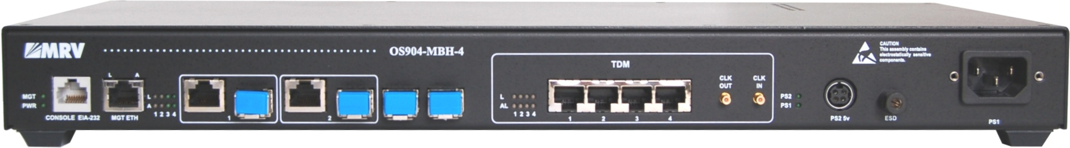
Introducing the OS904-MBH-4 & OS904-MBH-4A
Combines Ethernet timing synchronization with 4 x E1/T1 ports
Supports SyncE & 1588 slave (frequency)* Timing & Synchronization
Hardened model (supports temperature range of 0^{O}C to +65^{O}C)
Redundant external power supply
Synchronous Ethernet UNI / NNI ports
4 x E1/T1
CES interfaces
SMBs for Clock In/Out
Additional external PS
OS904-MBH-4 functions:
E1/T1 TDM over PSN voice (CES)
Layer 1 Clock Sync or Adaptive Clocking
Protocol Based 1588 Slave (frequency)
UNI/E-NNI demarcation
SLA measurements based on dedicated OAM processor
E1 voice & Clock
SyncE
Network
Ethernet – Data
1588v2 is available only in PN OS904-MBH-4A

Slide 4
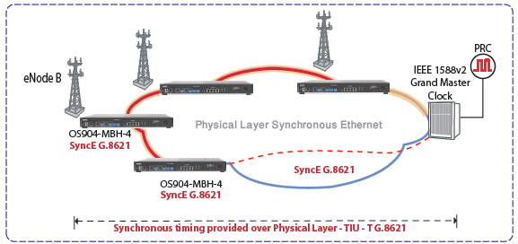
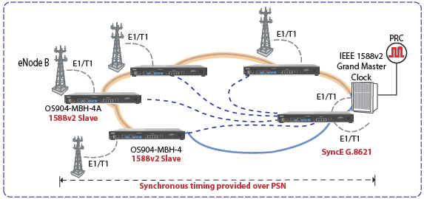
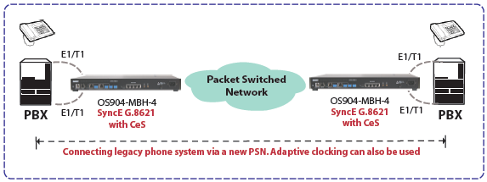
Applications
Cell site Demarcation device for a Synchronous Ethernet based mobile backhaul
Cell site Circuit Emulation Services (CES) supporting device with 1588v2 synchronization
Circuit Emulation Services (CES) supporting device for legacy voice services

Slide 5
Improved Device Capabilities
OAM
OS904-MBH-4 HW-based (RFC2544 included)
OS910-M SW-based
CES Synchronization
OS904-MBH-4 Based on SyncE, 1588v2 & Adaptive Clocking
OS910-M Based on Adaptive Clocking
Supported Temperature Range
OS904-MBH-4 0^{O}C – 65^{O}C
OS910-M 0^{O}C – 50^{O}C
CES Standards
OS904-MBH-4 SATOP, CESoPSN, MEF8, TDMoIP
OS910-M SATOP, CESoPSN, MEF8
Max #CES Sessions
OS904-MBH-4 64
OS910-M 32
CES Performance Monitoring
OS904-MBH-4 ES (error seconds), SES (Severely Error Seconds), UAS (Unavailable Seconds)
OS910-M -NA

Slide 6

Key Benefits
State-of-the-art Timing models for circuit Emulation Services
Supporting most CES protocols
Low Capex and Opex
  A combined Carrier Ethernet, CES and Synchronization capabilities on a single fixed pizza box for all MEF 22 mobile backhaul scenarios
  Embedded testing tool that enable customers to avoid purchasing sophisticated measurement equipment
  MEF oriented CLI (Pro-Vision® CLI) for minimal training for customers’ technical teams
Superb NMS for large Carrier Ethernet deployments

Slide 7




Thank You
Technology
Partnership
Knowledge

